Slide 1
Transportation Overview
House Transportation Committee
Subcommittee on Discretionary Funding Allocations
May 4, 2023

Slide 2
Transportation Funding in Texas
Traditional funds
  State Highway Fund (motor fuel tax, registration fees, federal reimbursements)
Non-traditional funds
  State Highway Fund (Proposition 1 and Proposition 7 funds)
Regional funds
  Toll revenues and concession fees
Texas Mobility Fund
  Historically handled bond revenues
  Title, license, inspection fees
Notes:
There are 4 main types of revenues that fund transportation in Texas.

Slide 3
State Highway Fund Revenues
Main Account:
State Motor Fuels Tax
Federal Highway Fund Reimbursements
Vehicle Registration Fees
Smaller Miscellaneous Revenues
Subaccounts:
Proposition 1- Oil & Gas Severance Tax
Proposition 7- Sales Tax
Notes:
The majority of these funds reside in the State Highway Fund. The State highway fund includes:

Slide 4
State Highway Fund FY22 Revenues
State Fuel Tax: $2.8B
Registration Fees: $1.6B
FHWA: $4.2B
Other Fed: $0.2B
Prop 1: $1.5B
Prop 7: $3.0B
Other: $0.7B
TxDOT: March 2023 Cash Forecast
Notes:
The graph below depicts the current transportation funding for Texas’ State Highway Fund. As can be noted from the percentages, the largest portion of funding stems from Federal Highway Administration (FHWA) reimbursements, which includes the federal gas taxes as well as a small portion of miscellaneous funds. The remaining sources include state motor fuel tax revenue, Proposition 7 funds, Proposition 1 funds, vehicle registration fees, and other funds.
$13.9B total

Slide 5
Motor Fuel Taxes
 | US National Average |  | Texas
 | Gasoline | Diesel | Gasoline | Diesel
State Excise Tax | 26.16 ¢ per gal | 26.72 ¢ per gal | 20.00 ¢ per gal | 20.00 ¢ per gal
Other State Taxes/Fees | 12.53 ¢ per gal | 13.52 ¢ per gal | 00.00 ¢ per gal | 00.00 ¢ per gal
Total State Taxes/Fees | 38.69 ¢ per gal | 40.24 ¢ per gal | 20.00 ¢ per gal | 20.00 ¢ per gal
Federal Tax | 18.40 ¢ per gal | 24.40 ¢ per gal | 18.40 ¢ per gal | 24.40 ¢ per gal
Total State and Federal Taxes | 57.09 ¢ per gal | 64.64 ¢ per gal | 38.40 ¢ per gal | 44.40 ¢ per gal
Notes:
We’ll start with the Motor fuels tax- shown in green on the pie chart.
At the state level, the motor fuels tax has historically been used as a primary way to fund transportation in Texas. The per gallon tax on gasoline and diesel fuel was established at 20 cents in 1991, and of that 20 cents per gallon, 25 percent is diverted to public education. In the 30 years since the gas tax rate was last adjusted, many factors such as population growth, improvements in vehicle fuel efficiency, and highway construction costs and inflation have impacted the revenue yields from the fuel tax.
Last I checked we ranked 44th in the nation.

Slide 6
Federal Reimbursements
Federal funds represent nearly 1/3 of the budget.
Federal motor fuel taxes are collected and then distributed to the states using formulas for highway and transit.
Since 2008 Congress has added general revenue to the Highway Trust Fund to help keep up with increased demand.
Historically Texas has been the biggest donor state; receiving less in reimbursements than paid into the Highway Trust Fund.
Notes:
Federal reimbursements- shown in blue on the pie chart, represent nearly 1/3 of the budget.

Slide 7
Vehicle Registration Fees
Motorcycles/ Mopeds | $30.00
Passenger Vehicles | $50.75
Trailers/ Travel Trailers | $45.00
All Vehicles 6k-10k lbs | $54.00
10k to 18k | $110.00
18k to 26k | $205.00
26k to 40k | $340.00
40k to 55k | $535.00
55k to 70k | $740.00
70k to 80k | $840.00
Notes:
Vehicle registration fees (shown in yellow) are paid annually, and this chart shows the state portion of the fee. You’ll notice that the fee schedule increases with the weight of the vehicle.

Slide 8
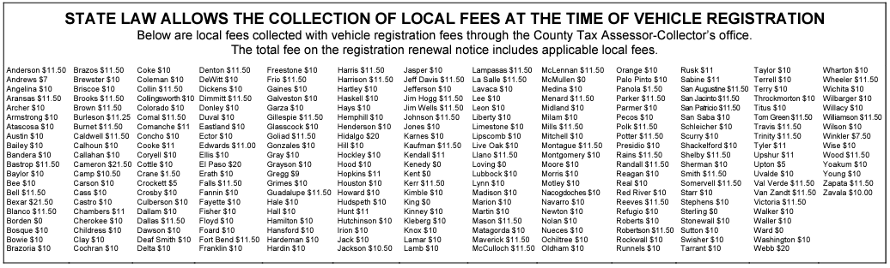
Local Vehicle Registration Fees
Table: TxDMV
Notes:
In addition to the state vehicle registration fee, the law allows for local fees that can range from $0 to $31.50. Counties can charge up to $10 for road and bridge projects, $20 for long-term road projects and $1.50 for child safety programs.
Limitations are based on population, county location, and established regional mobility authority (RMA).

Slide 9
Proposition 1 & 7 Revenues
Proposition 1:
Allowed a portion of existing oil and natural gas severance taxes to be divided evenly between the Economic Stabilization Fund and the State Highway Fund.
Used for “constructing, maintaining, and acquiring rights-of-way for public roadways other than toll roads.”
Proposition 7:
$2.5 billion of the net revenue from the state sales and use tax that exceeds the first $28 billion of that revenue is sent to the SHF.
35% of motor vehicle sales and rental tax revenue above $5 billion is sent to the SHF.
Notes:
In 2014 and 2015, the voter approvals of propositions 1 and 7 provided new sources of revenue for transportation in Texas. These sources have contributed significant portions of revenue to the transportation funding mix. The propositions have been an important source of revenue in recent years, but these revenue sources are largely susceptible to the economic circumstances of the state of Texas due to the generation of these funds from oil and gas severance taxes and sales and use taxes.

Slide 10
State Highway Fund FY22 Expenses
Plan: $1.5B
Build: $2.1B
Maintain: $4.0B
Use: $0.1B
Manage: $0.4B
Prop 1 Projects: $1.1B
Prop 7 Projects: $2.8B
Prop 14 DS: $0.3B
Prop 12 DS: $0.3B
Other Agencies: $0.4B
TxDOT: March 2023 Cash Forecast
Notes:
Plan: engineering, ROW acquisition, research
Build: new and existing highway projects
Maintain: new and existing highway projects (Preservation), routine maintenance
Use: public transportation, travel, traffic safety
Manage: support services, information resources, administration
Prop1 & Prop 7 Project Development & Delivery
Debt Service
Other agency and fund transfers
$13.0B

Slide 11
Transportation Organizations
MPO
COG
Toll
Transit
RMA
RTPO
Notes:
It’s important to think about transportation planning as ONE process with several different partners.

Slide 12
Transportation Planning in Texas
25 TxDOT Districts
23 Metropolitan Planning Organizations (MPOs)
24 Councils of Government (COGs)
24 Lead Agencies – Regional Transit (24)
13 RTPO (13 established 21 with resolutions)
10 Regional Mobility Authorities (RMAs)
Others (e.g. 391’s)
Notes:
Others: Within Chapter 391 of the Local Government Code, there is reference to the formation of “sub-regional” planning commission. In past years, several “sub-regional” planning commissions were established by local officals. These include: the Eastern Central Texas, Trinty Neches Texas, Piney Woods, Waller County Texas, Attoyac, South Central Texas, AGRO, Big Bend, and Grimes County Sub-Regional Planning Commissions.

Slide 13
Metropolitan Planning Organizations
MPOs represent localities in all urbanized areas with populations greater than 50,000.
Urbanized areas with populations greater than 200,000 are called Transportation Management Areas (TMA).
MPO/TMA planning processed must comply with federal requirements to develop transportation plans.
Each MPO receives federal funding for planning activities and many also receive state and local funds as well.
Notes:
Transportation planning in Texas occurs in both rural and urban areas. MPOs are federally mandated and funded to address regional planning needs. Composed of local elected officials and representatives of state agencies, MPOs ensure that transportation planning in urban areas is developed cooperatively and guided by local and public input. MPOs work to balance the planning needs of local communities with the need for statewide connectivity, putting some of the planning process back in the hands of locals.
MPOs receive funding through federal, state, and local sources for their operation. Federal transportation funds are channeled through TxDOT to the MPOs, but state and local governmental entities may also support MPO planning activities with matching grants, employee salaries and benefits, contract oversight, information technology services, and more.
Only first 2 bullets

Slide 14
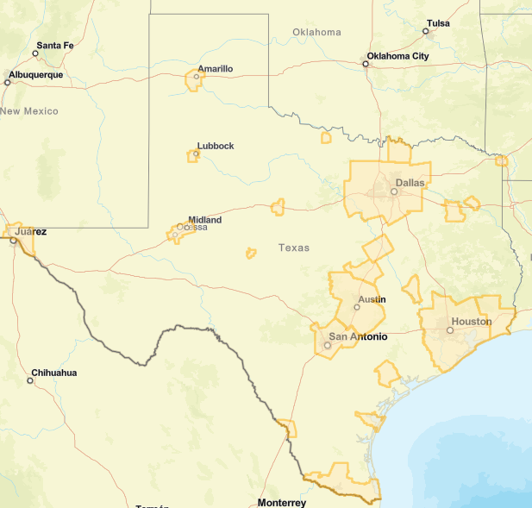
MPO Map
Map: TxDOT
Notes:
Some MPOs are stand-alone agencies, while some are found within other agencies such as cities, counties, or councils of governments. The governance of the MPO resides internally within its policy board, which is free to adopt policy, bylaws, and organizational procedures. MPOs typically also form advisory boards and committees to assist them in their decision-making process.

Slide 15
List of Texas MPOs
Abilene MPO
Alamo Area MPO (TMA)
Amarillo MPO
Austin MPO (CAMPO)(TMA)
Beaumont-Port Arthur MPO (SETRPC-MPO)
Bryan-College Station MPO
Corpus Christi MPO (TMA)
Dallas-Fort Worth MPO (NCTCOG)(TMA)
El Paso MPO (TMA)
Houston-Galveston MPO (HGAC)(TMA)
Grayson County MPO
Killeen-Temple MPO (KTMPO)(TMA)
Laredo & Webb County MPO
Longview MPO
Lubbock MPO (TMA)
Permian Bason MPO (TMA)
Rio Grande Valley MPO (TMA)
San Angelo MPO
Texarkana MPO
Tyler Area MPO
Victoria MPO
Waco MPO
Wichita Falls MPO

Slide 16
Regional Transportation Planning Organization
RTPOs (formerly Rural Planning Organizations RPOs)
Voluntary organizations that provide rural transportation planning support.
Provide recommendations and priorities to TxDOT in areas NOT included in MPO.
TxDOT and RTPO develop the rural improvement plan cooperatively.
No dedicated funding.

Slide 17
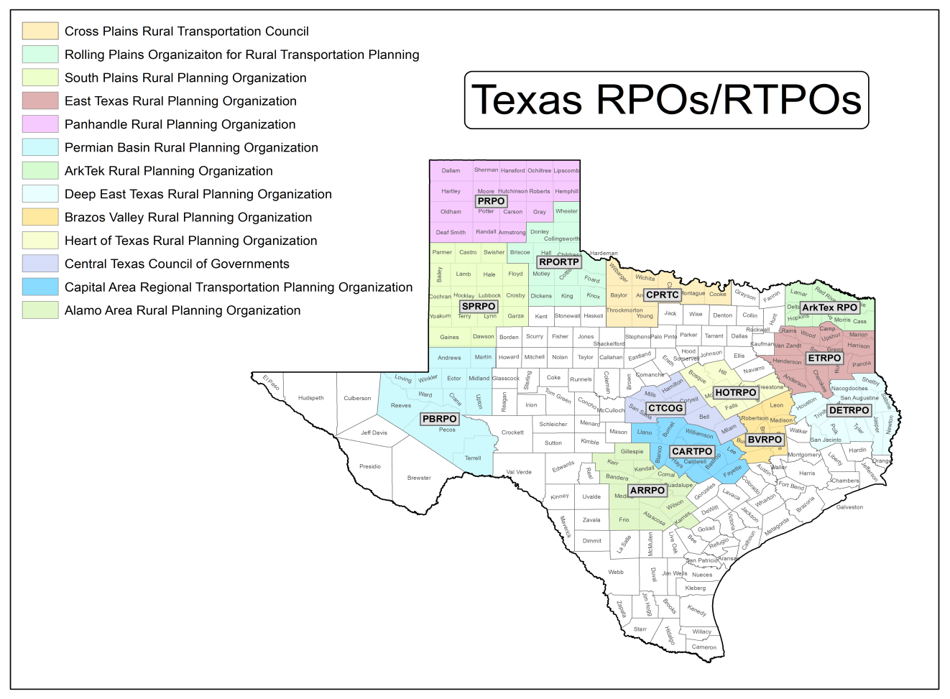
RTPO Map

Slide 18
Regional Council of Governments
There are 24 COGs and Regional Planning Commissions (RPCs) that we refer to as COGs in general.
Voluntary organizations of local governmental entities that coordinate programs and services to address needs that cross jurisdictional boundaries.
By definition and original purpose, they are focused on transportation planning. But as we know many MPOs are housed in COGs and share staff and expertise, and in many cases may be the primary transportation planning entity for the region.
Notes:
There are 24 COGs, RPCs, we will refer to all of these as COGs.
COGs /RPC, by definition and original purpose, are focused on transportation planning. But as we know many MPOs are housed in COGs and share staff and expertise, and many cases may be the primary transportation planning entity for the region.
There are 16 Cogs that have passed resolutions, either supporting RPOs, or establishing themselves as the RPO for their region.
Not all of the 16 COGs have active RPOs.

Slide 19
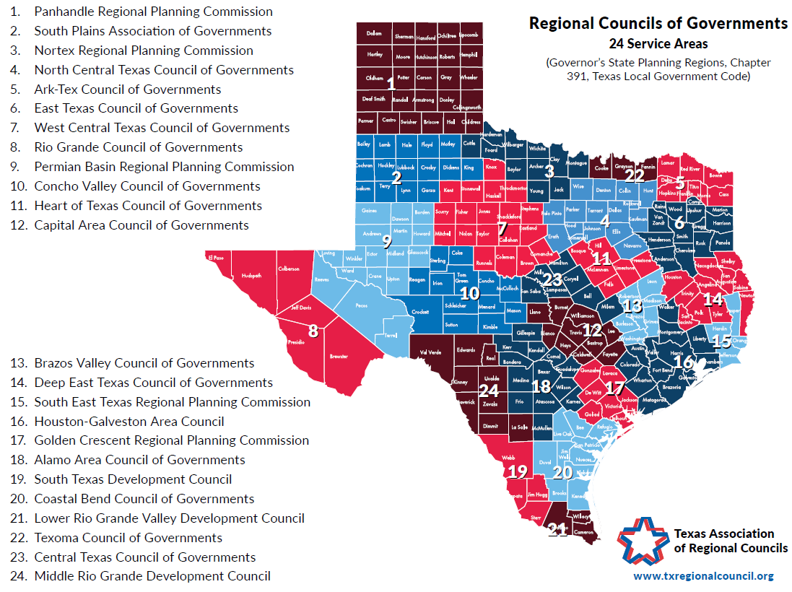
COG Map
Notes:
Boundaries are not the same as the TxDOT districts – meaning a COG might include several districts.

Slide 20
Regional Mobility Authorities
A regional mobility authority (RMA) is a political subdivision formed by one or more counties to acquire, design, finance, construct, operate, maintain, expand or extend transportation projects. These projects may be tolled or non-tolled. Authorized by the Commission.
  Issue bonds
  Establish tolls
  Apply for federal funds
  Apply for State Infrastructure Bank (SIB) loans
Notes:
There are 10 RMAs
REGIONAL MOBILITY AUTHORITY POWERS
• Develop a transportation project.
• Issue revenue bonds.
• Establish tolls.
• Acquire property for transportation projects.
• Use surplus revenue to finance other local transportation projects.
• Apply for federal highway and rail funds.
• Enter into contracts with other governmental entities and Mexico.
• Apply for State Infrastructure Bank loans. (must be eligible under federal highway programs, on or off system, construction or reconstruction)
• Set speed and weight limits on Regional Mobility Authority facilities consistent with state and federal guidelines.
• Enter into agreements with other governmental entities to develop a transportation project on behalf of that entity.
The SIB program allows borrowers to access capital funds at or below-market interest rates. The SIB operates as a revolving loan fund, where the account balance grows through the monthly interest earned and repaid principal and interest payments.

Slide 21
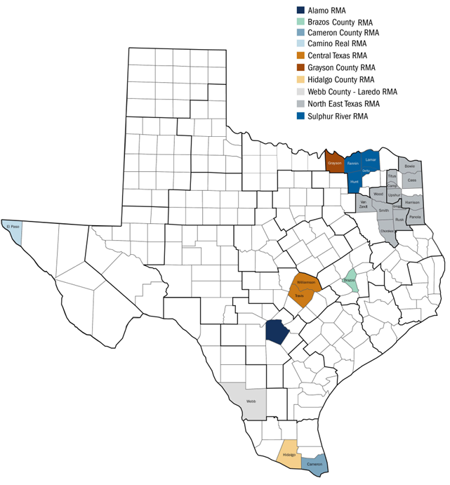
RMA Map
Map: TxDOT

Slide 22
Rural Public Transit
Federal transit funds are administered by TxDOT in accordance with Federal Transit Administration (FTA) regulations.

Slide 23
Toll Authorities
Statewide Toll Authorities:
  TxDOT (TxTag)
Regional Toll Authorities:
  North Texas Tollway Authority (TollTag)
RMAs
County Toll Authorities:
  Harris County (EZTag)
  Brazoria County
  Ft Bend County
  Montgomery County
  Collin County
Notes:
County: There are multiple tolling agencies operating toll roads in the Houston-Metropolitan area.
The Grand Parkway is operated by two separate entities – the Texas Department of Transportation (TxDOT) and the Fort Bend County Toll Road Authority (FBCTRA).
Sections of the Westpark Tollway and Fort Bend Parkway are also operated by the FBCTRA. A section of the Tomball Tollway (SH-249) is operated by the Montgomery County Toll Road Authority (MCTRA).
The HOT lanes on IH 45, US 290, and US 59 are operated and maintained by the Metropolitan Transit Authority of Harris County (METRO). The SH-288 Express Toll Lanes are operated by the Blueridge Transportation Group (BTG) on behalf of the Texas Department of Transportation (TxDOT) and the Brazoria County 288 Expressway is operated by the Brazoria County Toll Road Authority (BCTRA).

Slide 24
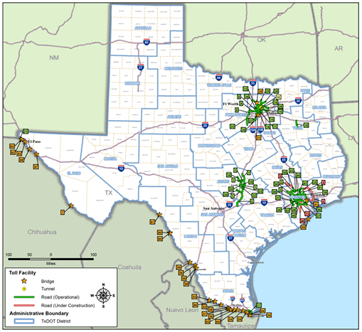
Toll Road and Toll Bridge Map
Map: TxDOT

Slide 25
Brianne Glover, J.D.
Research Scientist

